Slide 1
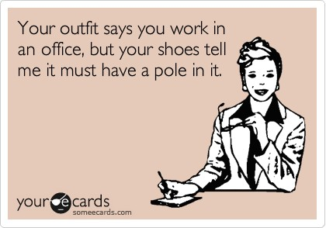

Slide 2
Professional Etiquette Attire and Events
By,
Sarah Nuzzo, Andrea Costello, Casey Lynott, Dominico McIntosh

Slide 3
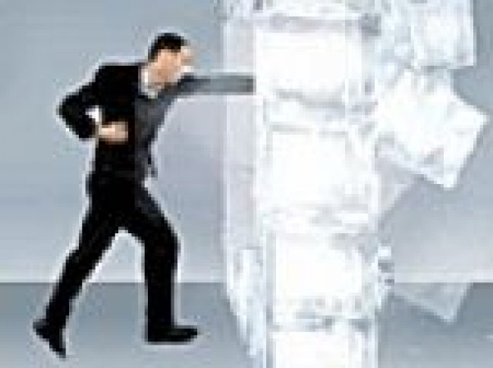
Ice Breaker
Name
Year
One thing you would like to learn about professional etiquette
OR
One thing you know/would like to share about professional etiquette

Slide 4
Our Workshop
Making a positive first impression
What is professional attire?
Tie tying exercise
Key pieces to purchase
Building your wardrobe
Online shopping exercise
Business social events dos and don’ts
Thank you notes
Class writing exercise

Slide 5
Positive First Impression
Areas of focus:
The manner in which you enter the room
The nonverbal messages you
send the moments following your entrance.

Slide 6
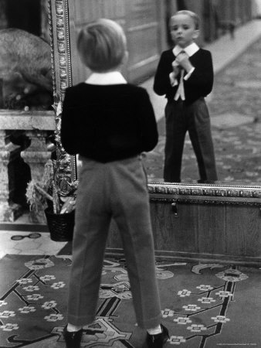
Making a First Impression
Think before entering the room: “What impression do I want to convey?”
Rehearse a mental image of yourself successfully making a good entrance, with confidence, making great eye contact and smiling
Use positive talk when creating this
image, and use it against any objections
Be yourself
RELAX!

Slide 7
Be confident through Nonverbal Communication
“Visual components and the way a person’s voice sounds account for 93% of the person’s believability” (Clarke, 2005)

Slide 8
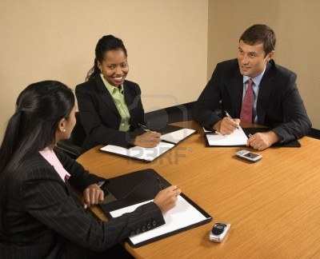
Nonverbal Cues
Appearance:
Neat and professional. Keep hair tidy, clothes pressed and fitted and be well groomed.
Take cues from upper level management on appropriate professional appearance.
Eye Contact:
Strong consistent eye contact shows that you are interested.
Helps engage in your audience and keeps people engaged in what you have to say.
Facial Expressions:
Smile often when meeting new people or presenting information, make sure your other expressions match your smile.
Avoid frowning –ask questions to clarify confusion

Slide 9
Nonverbal Cues
Gestures:
Nod your head when someone is speaking to indicate you are actively listening.
Greet people with a firm hand shake.
Hold the door for your colleagues as a gesture of respect.
Avoiding standing with your hands folded or in your pockets.
Posture:
Great posture is an integral part of your nonverbal communication
Walk in a purposeful, calm, natural manner---communicates trustworthiness and self-assurance.
Poor posture like leaning or slouching makes you look uninterested in your environment

Slide 10
Nonverbal Cues
Make sure your non-verbal communication matches your verbal communication
Not all nonverbal communication is interpreted the same– make sure you are fully aware of your settings. Some gestures here may mean something else in an international setting.

Slide 11
Proper Introductions
“Think of the person you want to honor most, and mention that person's name first” (Bixler, 1997).
Example: Ms. Sarah Nuzzo (Company CEO)
Ms. Andrea Costello (Divisional Manager)
“Ms. Nuzzo, I would like to introduce Ms. Andrea Costello. Andrea, Ms. Sarah Nuzzo”
Introductions should be followed by a few comments about the individual such as a common interest to initiate conversation between the individuals.

Slide 12
Professional Attire 101
Women:
Dark blue, black, or grey suits
Blouse
2.5” heels or less
Leather briefcase/portfolio

Slide 13
Professional Attire 101
Women:
Light to no perfume
Small mints
Groomed hair
Clean, cut nails
Natural
Minimum Jewelry

Slide 14
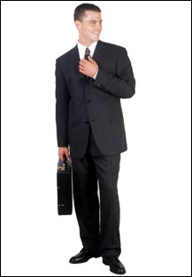
Professional Attire 101
Men:
Black, dark blue, or gray two piece dress suit
Fit
White dress shirt
Polished dress shoes
Dark socks
Leather belt

Slide 15
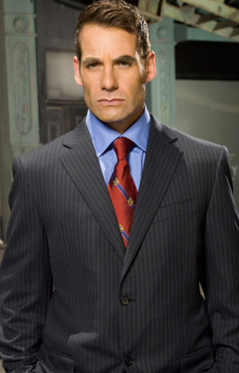
Professional Attire 101
Men:
Silk neck tie
Minimal jewelry: watch
Blue, black or taupe briefcase
Attractive, good fitting outer coat
Groomed nails
Attractive hairstyle

Slide 16
How To: Tie a Tie Exercise
https://www.youtube.com/watch?v=a1oKs8fvYQg

Slide 17
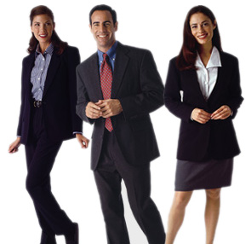
Staple Pieces to Purchase
2-piece suit
Neutral color
Tailored!
Ladies: pant-suit or
skirt-suit is acceptable

Slide 18
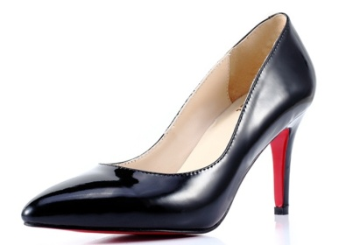
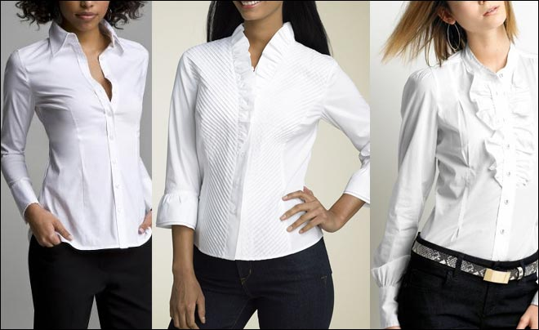
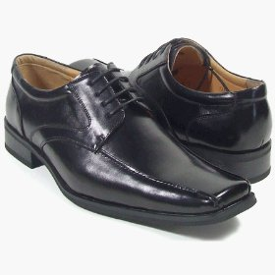
Staple Pieces to Purchase
White Button Up Shirt
Simple; matches all items in your wardrobe
Black Dress Shoes

Slide 19
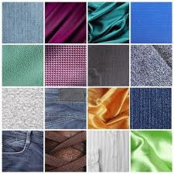
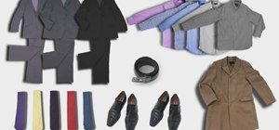
Adding Interest to your Work Attire
T
E
X
T
U
R
E
Cardigans
Colors
Dresses

Slide 20
Where to Shop
Discount Stores:
TJ Maxx
Ross
DSW
Department Stores:
Target
Walmart
Kohls
JCPenney
Consignment Shops:
Plato’s Closet
Individual Retailers and Factory/Outlet Stores:
Old Navy
J. Crew
Ann Taylor, LOFT
Men’s Warehouse

Slide 21
Building Your Wardrobe
Class Exercise:
You have 5 minutes and $100 to spend. Please put together a wardrobe containing as many as the staple pieces to purchase as you can using the example places to shop.

Slide 22
Holiday Office Parties 10 Dos and Don’ts

Slide 23
Holiday “Office” Parties
Dos:
Decide if you will drink ahead of time
Dress appropriately
Make proper intros
Put your phone away
Thank you’s

Slide 24
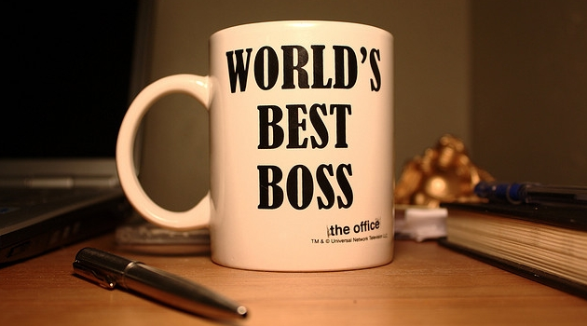
Holiday “Office” Parties
Don’ts:
Skip the party
Over consume, anything
Talk gossip, politics, or religion
Give the boss a gift
Invade the privacy of fellow employees

Slide 25
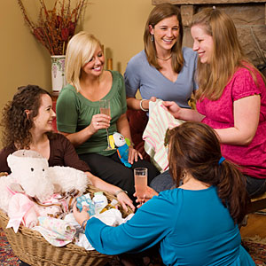
Celebrations in the Office
Engagements, Birthdays,
Baby Showers, Weddings,
and Graduations
Celebrating with a close friend versus an acquaintance in the office
Gift-giving strategies and ideas

Slide 26
Thank You Notes
Example:
Sarah,
Thank you for the extra effort you put into the professional etiquette presentation. Your added touch to the power point made the presentation more cohesive. You did an exceptional job presenting, and I appreciated the creative ideas you contributed.
Andrea
Personalized to a specific person
Express Thanks
Address a specific aspect of the event/action you appreciated or enjoyed
Close with a personal idea, statement, etc.

Slide 27
Questions?

